Slide 1
SIR GURUDAS MAHAVIDYALAYA
Workshop
Organized by IQAC & Career Counseling Cell
Title: “Employability Skills and Career Enhancement”
Chief Patron: Dr. Manishsankar Roy, Welcome Address by Sinjini Basu, IQAC.
Date : 15th Sept 2023, 3.00 PM at Room : 15
Speaker : Dr. Suchismita Majumdar, Librarian, Sir Gurudas Mahavidyalaya | Career Counseling : B Com : Pallav Kumar Saha Chowdhury,Faculty BA : Dr. Prasanta Ghosh, Faculty BSc.Debashish Barman,Faculty

Slide 2
TCS -BPS Registration Help Desk
Organized by IQAC & Career Counseling Cell
Convenor : Debashish Barman
Date : 15th Sept 2023, 3.00 PM at Room : 15
Career Counseling : B Com : Pallav Kumar Saha Chowdhury,Faculty BA : Dr. Prasanta Ghosh, Faculty BSc. : Debashish Barman,Faculty

Slide 3
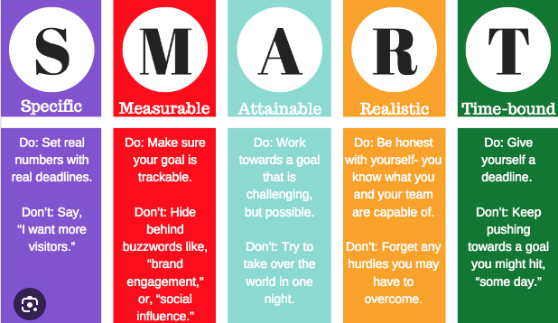

Slide 4
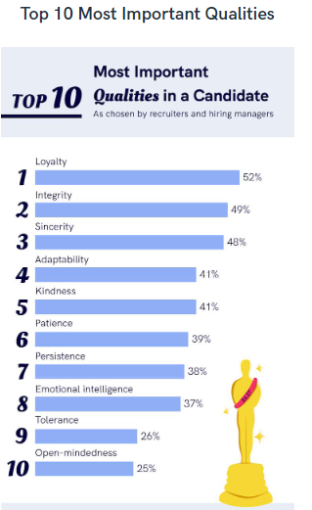
As per Most HR Manager
Top 10 Qualities of a Candidate

Slide 5
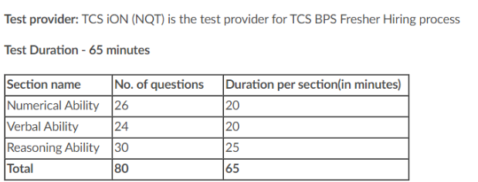
Exam Pattern

Slide 6
Links
Application | Link
Eligibility Criteria | Link
Steps to complete the Application Process | Link
Exam Pattern | Link Numerical Reasoning Ability Verbal Ability
Exam Content (Text based ) | Link
Exam Content (Video Based) | Link
Previous Year Question | Link
Google Form ( College End) | Link

